Slide 1

Spring Boot

Slide 2
Introduction :
Spring boot is used for create Standalone Spring based applications.
Spring boot provides Rapid Application Development
(Reduces the boiler plate code).
3. It is provide annotation based configuration to start a spring applications.
Notes:
Provides a good alternative to EJB for most applications
Provides end-to-end framework for applications.

Slide 3
Spring Boot Advantages :
Easy to develop spring based application by using java or groovy.
2. Reduce the development time and increase productivity.
Avoid XML based configurations. (e.g.: hibernate.cfg.xml and Spring.xml configurations).
4. Spring boot Provides embedded tomcat and jetty.
Spring boot gives property files and YAML files. We can use this property or YAML file for DB configurations and security provided things
By using Spring boot we can run application through main method and using command prompt
Notes:
Provides a good alternative to EJB for most applications
Provides end-to-end framework for applications.

Slide 4
Needed s/w :
Java 1.8 or above
Maven or Gradle
IDE (Eclipse/ IntiliJ /STS)

Slide 5
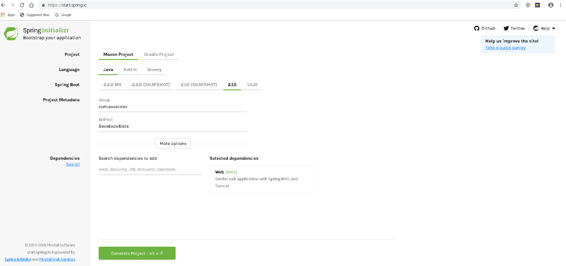
Create Spring Boot Project : Create Spring boot application by using https://start.spring.io/.

Slide 6
STEPS TO CREATE :
Select Maven Project and choose Java.
Change Artifact Name as Project name and change package name based on Project Name.
Select dependencies like web, JPA, Security.
Click Generate Project.
We will get Zip file. And we have to extract the Zip and import as a Maven project to IDE.
Note : We can create Spring boot and Maven project manually based on IDE.

Slide 7
Spring Boot Annotations :
@SpringbootApplication : we use this annotation to mark the main class of spring boot application.
This annotation encapsulates @EnableAutoConfiguration, @ComponentScan, @configuration annotations with their default attributes. Instead of using this 3 annotation we can use @SpringbootApplication annotation directly on class level.
@Autowired : we are using this annotation for bean injection. We can use this annotation for private properties and we can use for setter methods also.
@RestController/@Controller : This annotation is used to indicate the class is Spring Controller Class.
@Service : This annotation is used for indicate the class is Spring Service class.
@Repository : This annotation is used on java classes which directly access the database.

Slide 8
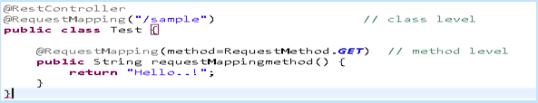
@RequestMapping : we can use this annotation Class level and method level. This annotation is used to map web request into specific controller method.
@GetMapping/@RequestMapping(method=RequestMethod.GET) : used for mapping HTTP GET requests to specific controller method.(fetch Data/get Data)
@PostMaping/@RequestMapping (method=RequestMethod.POST) : used for mapping HTTP POST requests to particular controller class handler method (Save).
@PutMapping/@RequestMapping (method=RequestMethod.PUT) : used for mapping HTTP PUT requests to particular controller class handler method.(Save or Update).
@DeleteMapping/@RequestMapping (method=RequestMethod.DELETE) : used for mapping HTTP DELETE requests to particular controller class handler method.(Delete).

Slide 9
@Qualifier : we are using this annotation for avoid confusion when u have more than one bean with same type, and you want to wire only one particular bean. Need to use along with @Autowired annotation.
@Bean : This annotation is used at method level. Using this annotation for Bean creation.
@PathVariable : This annotation is used to method arguments, it handles dynamic changes in URL where URL values act as parameter.

Slide 10
Spring boot Starter : spring-boot-starter-parent : parent for all dependencies spring-boot-starter-web : this dependency is used for web application spring-boot-starter-test : this dependency is used for testing related stuff.
<parent>
<groupId>org.springframework.boot</groupId>
<artifactId>spring-boot-starter-parent</artifactId>
</parent>
<dependency>
<groupId>org.springframework.boot</groupId>
<artifactId>spring-boot-starter-web</artifactId>
</dependency>
<dependency>
<groupId>org.springframework.boot</groupId>
<artifactId>spring-boot-starter-test</artifactId>
</dependency>

Slide 11

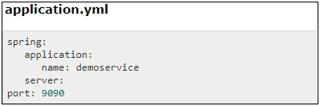
Property file :
Property files are used to keep number of properties in single file to run the application in different environments.
We will store spring boot properties in application.properties file.
We can use YAML file also instead of using application.property file.

Slide 12
Thank You

